Slide 1
Basics Probability
Session 03 - 04
Anom Yudistira

Slide 2
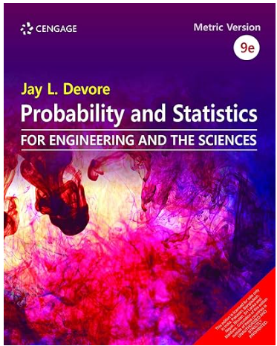
Jay L. Devore. (2020). Probability and Statistics for Engineering and the Sciences, 9E. Cancage Learning, Boston USA. ISBN-13: 978-0-538-73352-6
References

Slide 3
Sub Topics:
Sample Spaces and Events
Axiom, Interpretations, and Properties of Probability
Counting Techniques
Conditional Probabiity
Independence

Slide 4
Learning Object
LO 2: Calculate Descriptive Measures, Probability, Discrete
and Continuous Distribution

Slide 5
Introduction

Slide 6
What is Probability?
On the previous slide, we used graphs and numerical measures to describe data sets which were usually samples.
Probability is a tool which allows us to evaluate the reliability of our conclusion about the population when you have only sample information.

Slide 7
What is Probability?
We measured “how often” using
Relative frequency = f/n
As n gets larger,
Sample
And “How often”
= Relative frequency
Population
Probability

Slide 8
Sample Spaces and Events

Slide 9
Basic Concepts
An experiment is the process by which an observation (or measurement) is obtained.
An event is an outcome of an experiment, usually denoted by a capital letter.
  The basic element to which probability is applied
  When an experiment is performed, a particular event either happens, or it doesn’t!

Slide 10
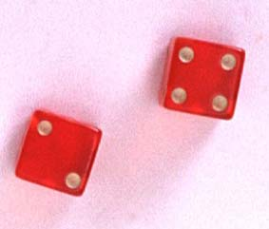
Experiments and Events
Experiment: Record an age
  A: person is 30 years old
  B: person is older than 65
Experiment: Toss a die
  A: observe an odd number
  B: observe a number greater than 2

Slide 11
Basic Concepts
Two events are mutually exclusive if, when one event occurs, the other cannot, and vice versa.
Experiment: Toss a die
  A: observe an odd number
  B: observe a number greater than 2
  C: observe a 6
  D: observe a 3
Not Mutually Exclusive
B and C?
B and D?
Mutually Exclusive

Slide 12
Basic Concepts
An event that cannot be decomposed is called a simple event.
Denoted by E with a subscript.
Each simple event will be assigned a probability, measuring “how often” it occurs.
The set of all simple events of an experiment is called the sample space, S.

Slide 13

Example
The die toss:
Simple events: Sample space:
1
E₁
E₂
E₃
E₄
E₅
E₆
S ={E₁, E₂, E₃, E₄, E₅, E₆}
2
S
3
E₁
E₃
4
E₅
5
E₂
E₆
E₄
6

Slide 14
Basic Concepts
An event is a collection of one or more simple events.
S
E₁
E₃
The die toss:
  A: an odd number
  B: a number > 2
A
E₅
B
E₂
E₆
E₄
A ={E₁, E₃, E₅}
B ={E₃, E₄, E₅, E₆}

Slide 15

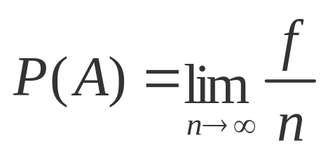
The Probability of an Event
The probability of an event A measures “how often” we think A will occur. We write P(A).
Suppose that an experiment is performed n times. The relative frequency for an event A is
If we let n get infinitely large,
The relative frequency of event A in the population

Slide 16
The Probability of an Event
P(A) must be between 0 and 1.
  If event A can never occur, P(A) = 0. If event A always occurs when the experiment is performed, P(A) =1.
The sum of the probabilities for all simple events in S equals 1.
The probability of an event A is found by adding the probabilities of all the simple events contained in A.

Slide 17
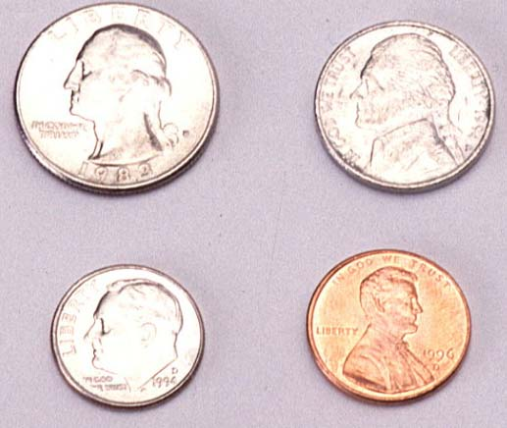
Finding Probabilities
Probabilities can be found using
  Estimates from empirical studies
  Common sense estimates based on equally likely events.
Examples:
  Toss a fair coin.
P(Head) = 1/2
10% of the U.S. population has red hair. Select a person at random.
P(Red hair) = .10

Slide 18
Calculate the Probabilities of an Event
List all the simple events in the sample space.
Assign an appropriate probability to each simple event.
Determine which simple events result in the event of interest.
Sum the probabilities of the simple events that result in the event of interest

Slide 19
Example
Toss a fair coin twice. What is the probability of observing at least one head?
1st Coin 2nd Coin E_{i} P(E_{i})
H
HH
1/4
1/4
1/4
1/4
P(at least 1 head)
= P(E₁) + P(E₂) + P(E₃)
= 1/4 + 1/4 + 1/4 = 3/4
H
T
HT
H
TH
T
T
TT

Slide 20
Example
A bowl contains three M&Ms®, one red, one blue and one green. A child selects two M&Ms at random. What is the probability that at least one is red?
1st M&M 2nd M&M E_{i} P(E_{i})
m
RB
1/6
1/6
1/6
1/6
1/6
1/6
m
m
RG
P(at least 1 red)
= P(RB) + P(BR)+ P(RG) + P(GR)
= 4/6 = 2/3
m
BR
m
m
BG
m
GB
m
m
GR

Slide 21
Axiom, Interpretations, and Properties of Probability

Slide 22
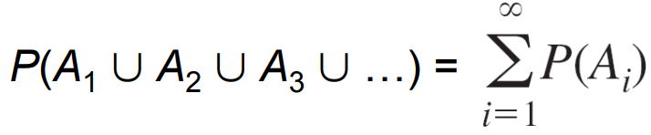
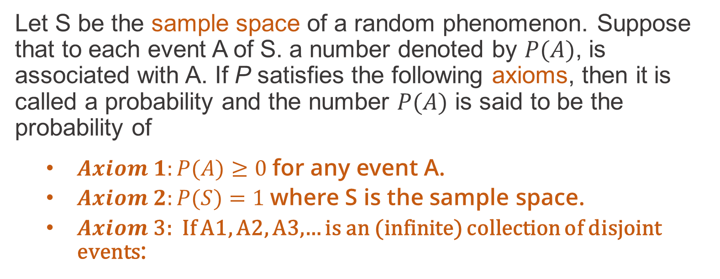
Axioms of Probability
Let S be the sample space of a random phenomenon. Suppose that to each event A of S. a number denoted by $P(A)$, is associated with A. If P satisfies the following axioms, then it is called a probability and the number $P(A)$ is said to be the probability of
  $Axiom 1:P(A)≥0$for any event A.
  $Axiom 2:P(S)=1$where S is the sample space.
  𝑨𝒙𝒊𝒐𝒎 3: If A1, A2, A3,… is an (infinite) collection of disjoint events:
  The probability of the empty set $P(∅)=0$

Slide 23

Axioms of Probability
  Let S be the sample space of an experiment. If S has N points that are all equally likely occur, then for any event A of S,
Example
Flipping a fair coin three times and A be the event at least two heads

Slide 24
Interpreting Probability
If the experiment is performed n times, in independent and identical fashion, the event A will occur (the outcome will be in the set A) in some of the replications. In other replications, A will not occur.
Let n(A) denote the number of replications on which A does occur.
Then the ratio n(A)/n is called the relative frequency of occurrence of the event A in the sequence of n replications of the experiment.

Slide 25
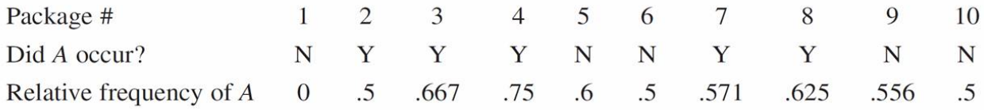
Example
Let A be the event that
“a package sent within the province west java for 2nd day delivery actually arrives within one day”
The results from sending 10 such packages (the first 10 replications (n=10) of the experiment) are as follows:
n(A) = 5; A occur. Did A occur? Yes (Y)

Slide 26
Example
Let A be the event that
“a package sent within the state of California for 2nd day delivery actually arrives within one day”
The results from sending 10 such packages (the first 10 replications (n=10) of the experiment) are as follows:
n(A) = 5; A occur, Did A occur? Yes (Y)

Slide 27
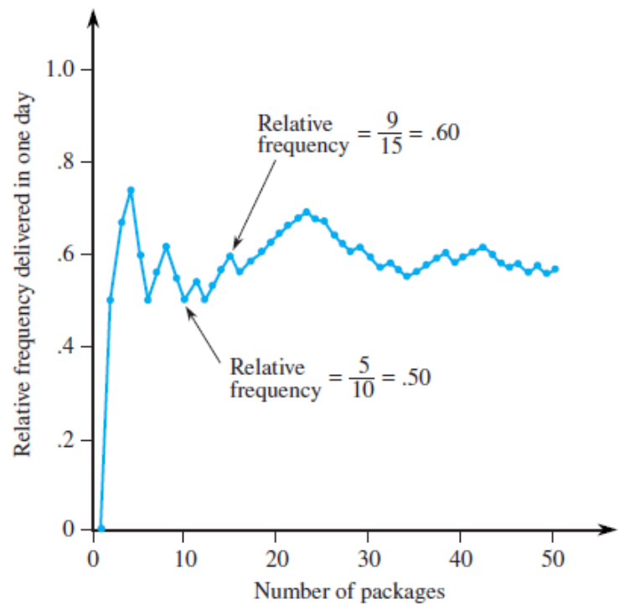
Example
The relative frequency n(A)/n fluctuates rather substantially over the course of the first 50 measurements.
(replications)

Slide 28
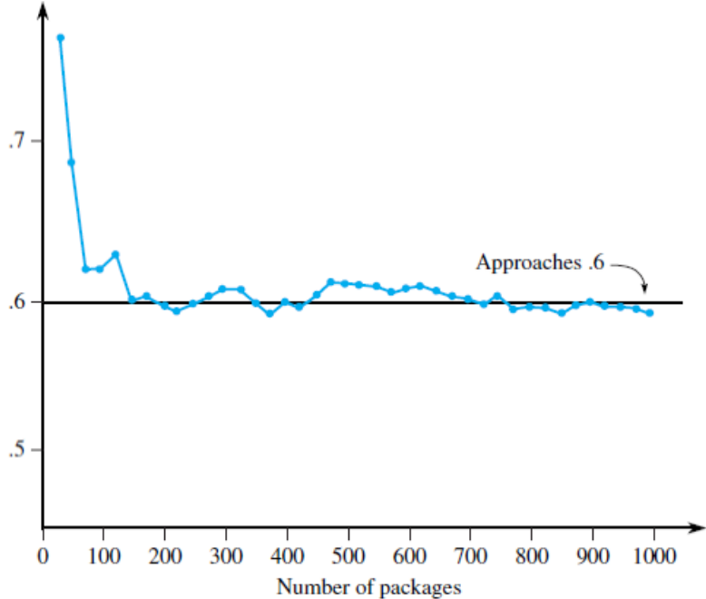
Example
But as the number of replications continues to increase, the
relative frequency stabilizes.
(replications)

Slide 29
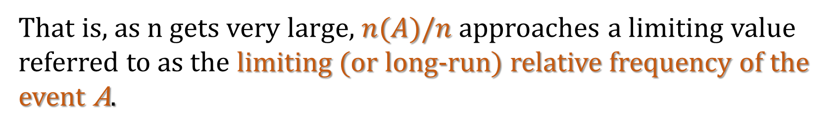
Interpreting Probability
Empirical evidence (based on the results of many such repeatable experiments) indicates that the relative frequency of this sort will stabilize as the number of replications n increases.
That is, as n gets very large, $n(A)/n$approaches a limiting value referred to as the limiting (or long-run) relative frequency of the event A.
The objective interpretation of probability states that this limiting relative frequency of an event A is the probability of that event, P(A).

Slide 30
Interpreting Probability
What does the statement “the probability of a package being delivered within one day of mailing is 0.6” really mean?
How does this relate to tossing a “fair coin”?

Slide 31
Counting Techniques

Slide 32
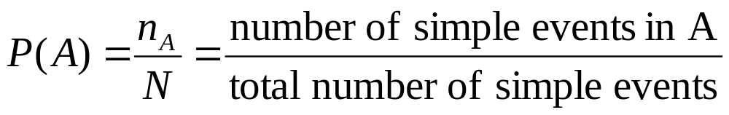
Counting Rules
If the simple events in an experiment are equally likely, you can calculate
You can use counting rules to find n_{A} = n(A) and N.

Slide 33
The mn Rule
If an experiment is performed in two stages, with m ways to accomplish the first stage and n ways to accomplish the second stage, then there are mn ways to accomplish the experiment.
This rule is easily extended to k stages, with the number of ways equal to
  n₁ n₂ n₃ … n_{k}
Example: Toss two coins. The total number of simple events is:
2 × 2 = 4

Slide 34

Examples
m
m
Example: Toss three coins. The total number of simple events is:
2 × 2 × 2 = 8
Example: Toss two dice. The total number of simple events is:
6 × 6 = 36
Example: Two M&Ms are drawn from a dish containing two red and two blue candies. The total number of simple events is:
4 × 3 = 12

Slide 35

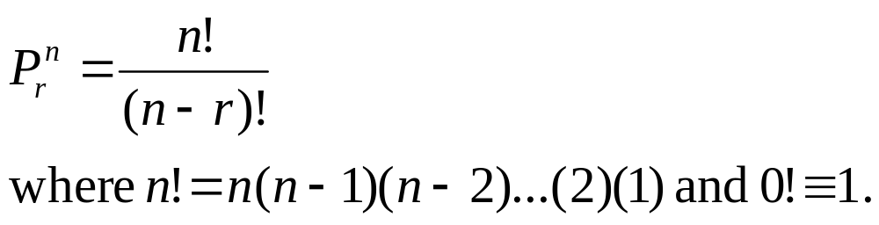
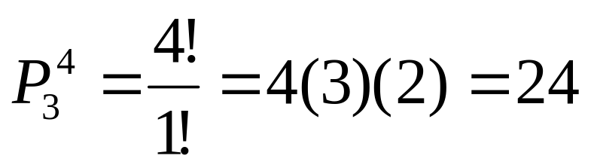
Permutations
The number of ways you can arrange
n distinct objects, taking them r at a time is
Example: How many 3-digit lock combinations can we make from the numbers 1, 2, 3, and 4?
The order of the choice is important!

Slide 36
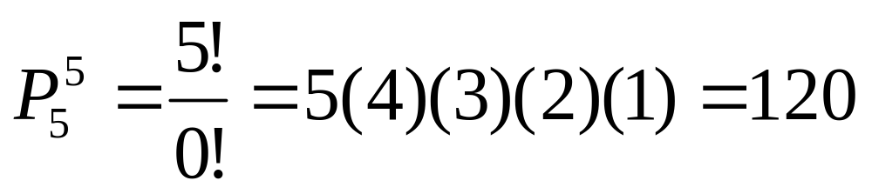
Examples
Example: A lock consists of five parts and can be assembled in any order. A quality control engineer wants to test each order for efficiency of assembly. How many orders are there?
The order of the choice is important!

Slide 37
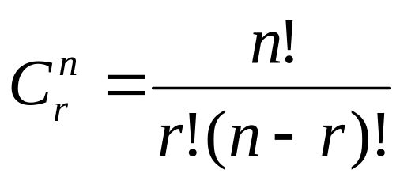
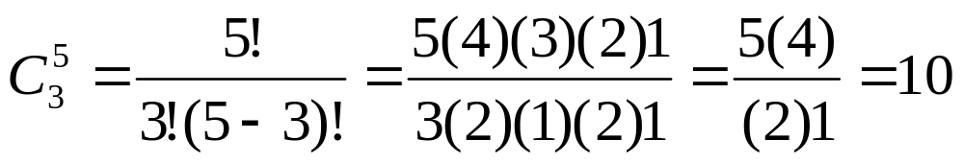
Combinations
The number of distinct combinations of n distinct objects that can be formed, taking them r at a time is
Example: Three members of a 5-person committee must be chosen to form a subcommittee. How many different subcommittees could be formed?
The order of
the choice is
not important!

Slide 38
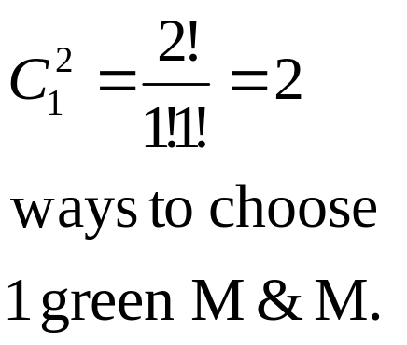
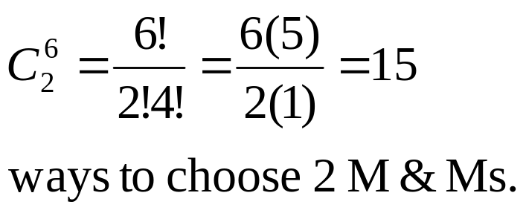
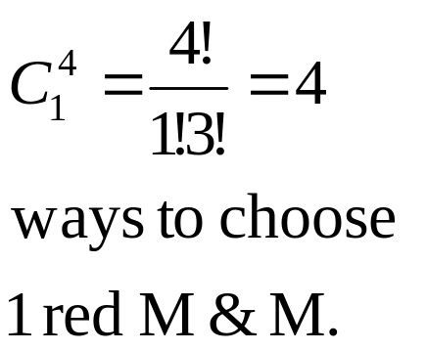
Example
m
m
m
m
m
m
A box contains six M&Ms®, four red
and two green. A child selects two M&Ms at random. What is the probability that exactly one is red?
The order of
the choice is
not important!
4 × 2 =8 ways to choose 1 red and 1 green M&M.
P( exactly one red) = 8/15

Slide 39

Event Relations
The union of two events, A and B, is the event that either A or B or both occur when the experiment is performed. We write
A ∪ B
S
A
B

Slide 40

Event Relations
The intersection of two events, A and B, is the event that both A and B occur when the experiment is performed. We write A ∩ B.
S
A
B
If two events A and B are mutually exclusive, then P(A ∩ B) = 0.

Slide 41
Event Relations
The complement of an event A consists of all outcomes of the experiment that do not result in event A. We write A^{C}.
S
A^{C}
A

Slide 42

Example
Select a student from the classroom and
record his/her ethnicity and gender.
  A: student whose ethnicity is Javanese
  B: student is female
  C: student is male
Mutually exclusive; B = C^{C}
What is the relationship between events B and C?
A^{C}:
B∩C:
B∪C:
Student does not Javanese
Student is both male and female = ∅
Student is either male and female = all students = S

Slide 43
Calculating Probabilities for Unions and Complements
There are special rules that will allow you to calculate probabilities for composite events.
The Additive Rule for Unions:
For any two events, A and B, the probability of their union, P(A ∪ B), is
A
B

Slide 44

Example: Additive Rule
Example: Suppose that there were 120 students in the classroom, and that they could be classified as follows:
A: Javanese
P(A) = 50/120
B: female
P(B) = 60/120
 | Javanese | Not Javanese
Male | 20 | 40
Female | 30 | 30
P(A∪B) = P(A) + P(B) – P(A∩B)
= 50/120 + 60/120 - 30/120
= 80/120 = 2/3
Check: P(A∪B)
= (20 + 30 + 30)/120

Slide 45

A Special Case
When two events A and B are mutually exclusive, P(A∩B) = 0 and P(A∪B) = P(A) + P(B).
A: male Javanese student
P(A) = 20/120
B: female Javanese student
P(B) = 30/120
 | Javanese | Not Javanese
Male | 20 | 40
Female | 30 | 30
P(A∪B) = P(A) + P(B)
= 20/120 + 30/120
= 50/120
A and B are mutually exclusive, so that

Slide 46
Calculating Probabilities for Complements
A^{C}
A
We know that for any event A:
  P(A ∩ A^{C}) = 0
Since either A or A^{C} must occur,
  P(A ∪ A^{C}) =1
so that P(A ∪ A^{C}) = P(A)+ P(A^{C}) = 1
P(A^{C}) = 1 – P(A)

Slide 47

Example
Select a student at random from the classroom. Define:
A: male
P(A) = 60/120
B: female
 | Javanese | Not Javanese
Male | 20 | 40
Female | 30 | 30
A and B are complementary, so that
P(B) = 1- P(A)
= 1- 60/120 = 60/120

Slide 48
Calculating Probabilities for Intersections
In the previous example, we found P(A ∩ B) directly from the table. Sometimes this is impractical or impossible. The rule for calculating P(A ∩ B) depends on the idea of independent and dependent events.
Two events, A and B, are said to be independent if and only if the probability that event A occurs does not change, depending on whether or not event B has occurred.

Slide 49
Conditional Probability

Slide 50
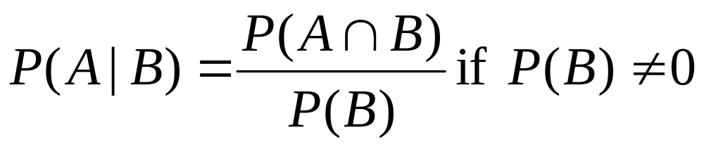
Conditional Probabilities
The probability that A occurs, given that event B has occurred is called the conditional probability of A given B and is defined as
“given”

Slide 51
Example 1
Toss a fair coin twice. Define
  A: head on second toss
  B: head on first toss
P(A|B) = ½
P(A|not B) = ½
HH
1/4
1/4
1/4
1/4
HT
P(A) does not change, whether B happens or not…
A and B are independent!
TH
TT

Slide 52
Example 2
A bowl contains five M&Ms®, two red and three blue. Randomly select two candies, and define
  A: second candy is red.
  B: first candy is blue.
m
P(A|B) =P(2nd red|1st blue)= 2/4 = 1/2
P(A|not B) = P(2nd red|1st red) = 1/4
m
m
m
m
P(A) does change, depending on whether B happens or not…
A and B are dependent!

Slide 53
Independence

Slide 54
Defining Independence
We can redefine independence in terms of conditional probabilities:
Two events A and B are independent if and only if
P(A|B) = P(A) or P(B|A) = P(B)
Otherwise, they are dependent.
Once you’ve decided whether or not two events are independent, you can use the following rule to calculate their intersection.

Slide 55
The Multiplicative Rule for Intersections
For any two events, A and B, the probability that both A and B occur is
P(A ∩ B) = P(A) P(B given that A occurred) = P(A)P(B|A)
If the events A and B are independent, then the probability that both A and B occur is
P(A ∩ B) = P(A) P(B)

Slide 56

Example 1
In a certain population, 10% of the people can be classified as being high risk for a heart attack. Three people are randomly selected from this population. What is the probability that exactly one of the three are high risk?
Define H: high risk N: not high risk
P(exactly one high risk) = P(HNN) + P(NHN) + P(NNH)
= P(H)P(N)P(N) + P(N)P(H)P(N) + P(N)P(N)P(H)
= (.1)(.9)(.9) + (.9)(.1)(.9) + (.9)(.9)(.1)= 3(.1)(.9)² = .243

Slide 57
Example 2
Suppose we have additional information in the previous example. We know that only 49% of the population are female. Also, of the female patients, 8% are high risk. A single person is selected at random. What is the probability that it is a high risk female?
Define H: high risk F: female
From the example, P(F) = .49 and P(H|F) = .08. Use the Multiplicative Rule:
P(high risk female) = P(H∩F)
= P(F)P(H|F) =.49(.08) = .0392

Slide 58
Bayes’ Rule

Slide 59
The Law of Total Probability
Let S₁ , S₂ , S₃ ,..., S_{k} be mutually exclusive and exhaustive events (that is, one and only one must happen). Then the probability of another event A can be written as
P(A) = P(A ∩ S₁) + P(A ∩ S₂) + … + P(A ∩ S_{k})
= P(S₁)P(A|S₁) + P(S₂)P(A|S₂) + … + P(S_{k})P(A|S_{k})

Slide 60
The Law of Total Probability
S₁
A
A ∩S_{k}
A ∩ S₁
S_{k}
S_{2….}
P(A) = P(A ∩ S₁) + P(A ∩ S₂) + … + P(A ∩ S_{k})
= P(S₁)P(A|S₁) + P(S₂)P(A|S₂) + … + P(S_{k})P(A|S_{k})

Slide 61
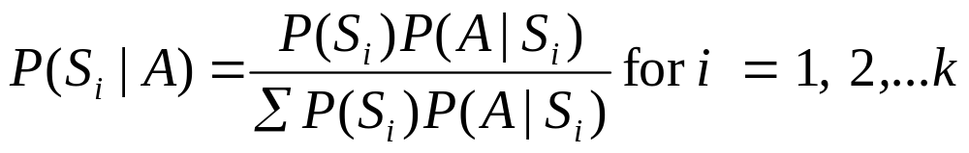
Bayes’ Rule
Let S₁ , S₂ , S₃ ,..., S_{k} be mutually exclusive and exhaustive events with prior probabilities P(S₁), P(S₂),…,P(S_{k}). If an event A occurs, the posterior probability of S_{i}, given that A occurred is

Slide 62
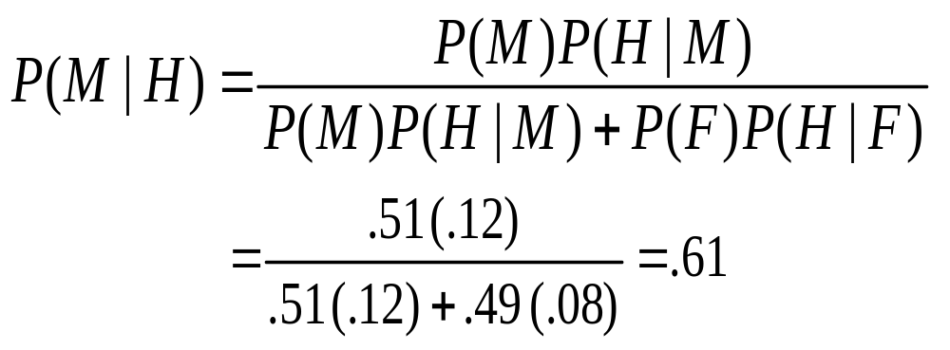
Example
From a previous example, we know that 49% of the population are female. Of the female patients, 8% are high risk for heart attack, while 12% of the male patients are high risk. A single person is selected at random and found to be high risk. What is the probability that it is a male?
Define H: high risk F: female M: male
We know:
P(F) =
P(M) =
P(H|F) =
P(H|M) =
.49
.51
.08
.12

Slide 63
Thank you
Februay 2023

Slide 64
References
Jay L. Devore. (2020). Probability and Statistics for Engineering and the Sciences, 9E. Cancage Learning, Boston USA. ISBN-13: 978-0-538-73352-6

